Slide 1


Slide 2

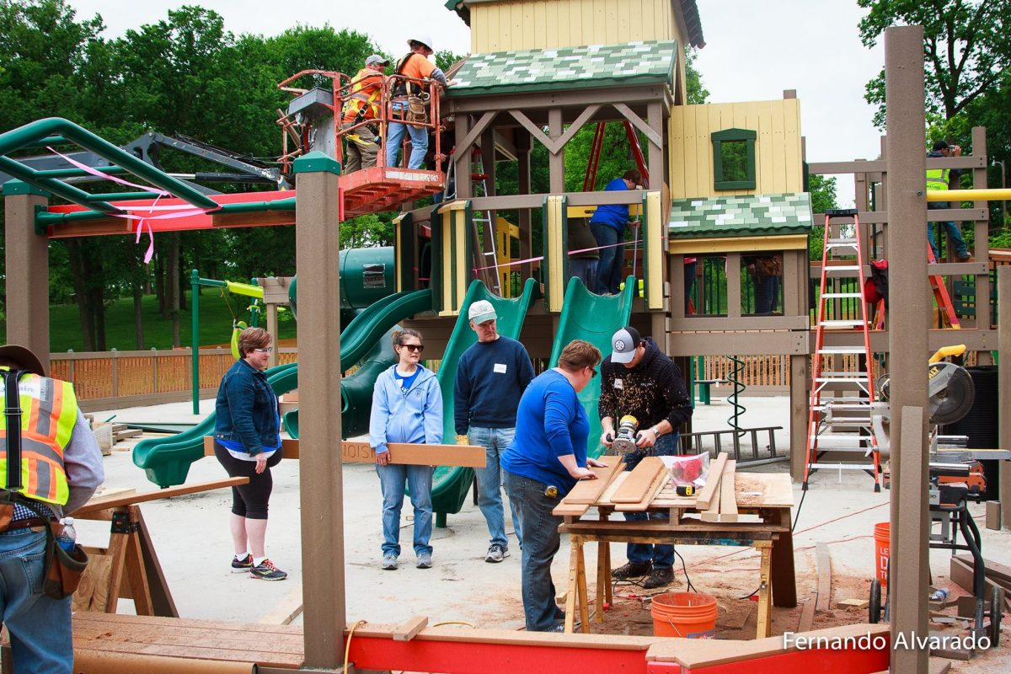
WILLMAR LAKE AREA VISION 2040
Create a better tomorrow through supporting projects that are community minded with special emphasis on the four focus areas.
DESTINATION PLAYGROUND

Slide 3
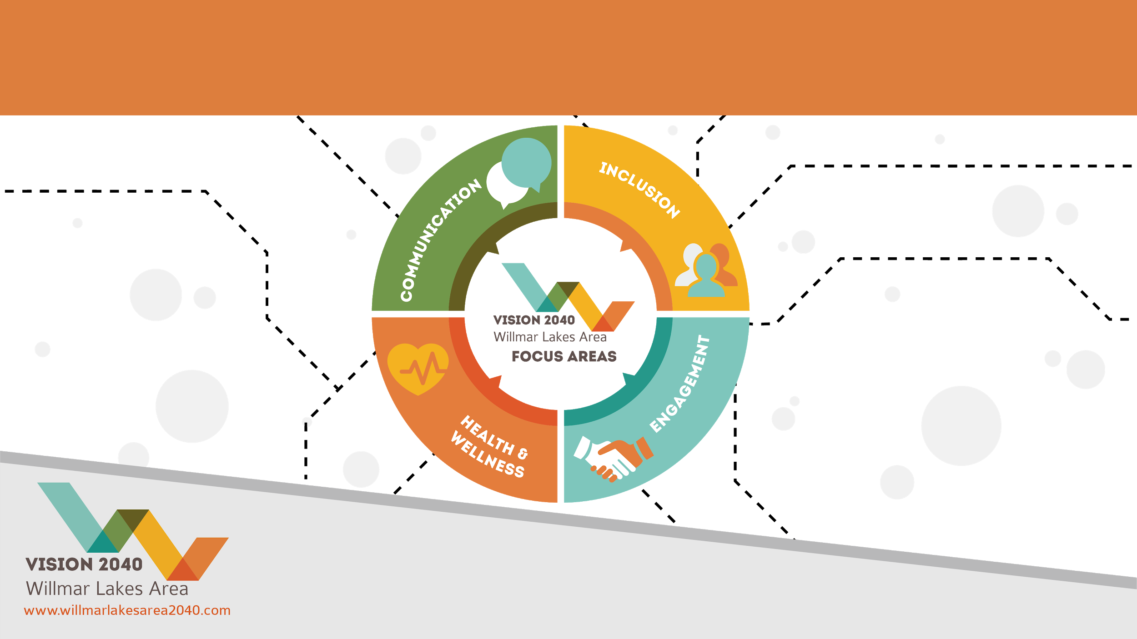
FOCUS AREAS

Slide 4

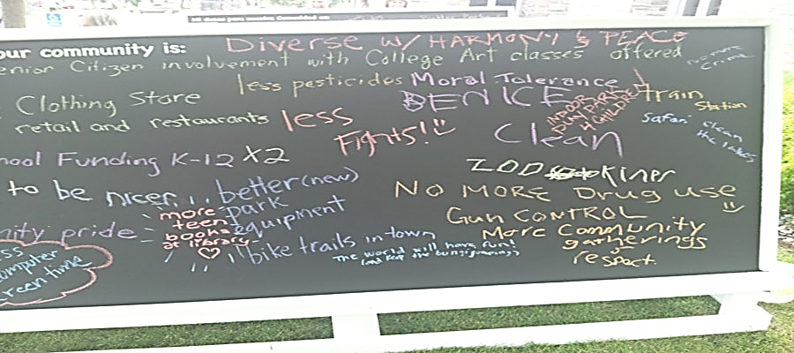
HISTORY
Willmar Lakes Area Vision 2040 is a collaborative, community-led and driven initiative of your neighbors, friends and coworkers of the Willmar Lakes Area.
The initiative began in the early 2000s and continues today!
Past Projects
Destination Playground
Kandiyohi County Dog Park
WeLead

Slide 5

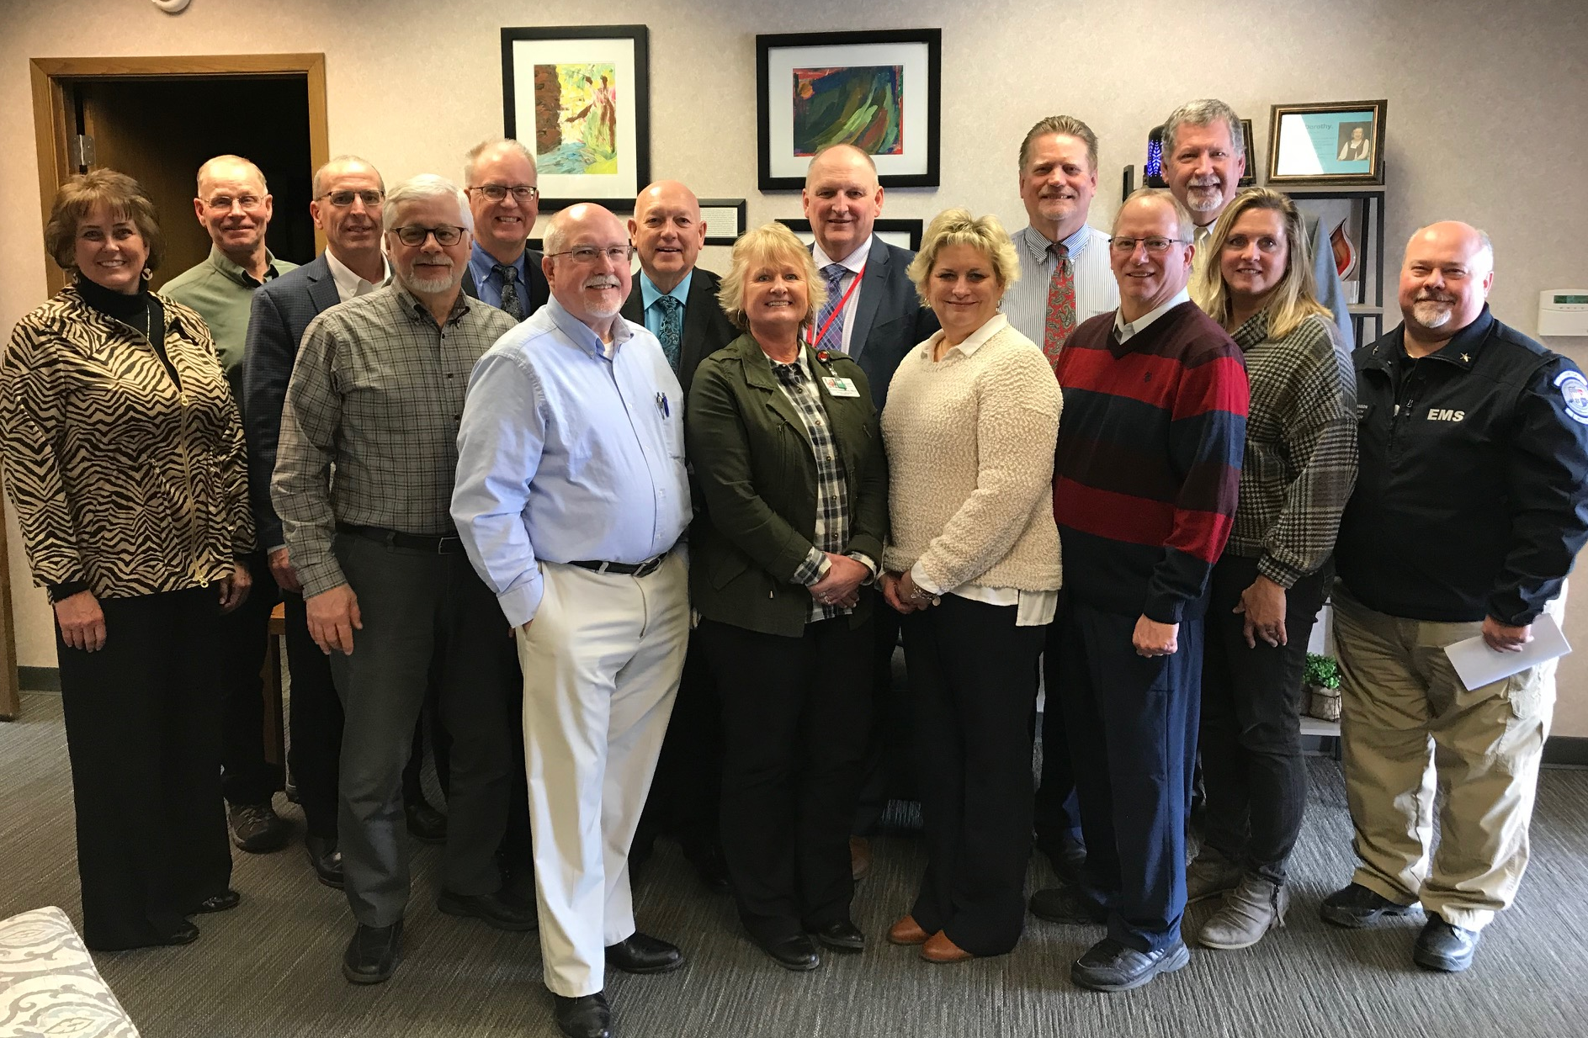
MEET THE STEERING COMMITTEE
Steve Ammermann, West Central Tribune
Aaron Backman, Kandiyohi County and City of Willmar Economic Development Commission
Sara Carlson, Willmar Area Community Foundation
Melanie Faust, Jennie-a Turkey Store
Wendy Foley, Blue Cross Blue Shield [BCBS]
Brad Hanson, Willmar Ambulance Service
John Harren, Willmar Municipal Utilities
Jeff Holm, Willmar Public Schools
Craig Johnson, Ridgewater College
Abdirahman Ahmed, Community Integration Center
Nagi Abdullahi, Center of Community Health Improvement
Ahmed Fowzi Ismail, Community Integration Center
Brian Gramentz, City of Willmar
Larry Kleindl, Kandiyohi County
Heather Koffler, VantagePoint Marketing Consultants
Jennifer Lindquist, Vision 2040 Leadership
Harlan Madsen, Kandiyohi County Commissioner
James Miller, Heritage Bank
Pablo Obregon, Southwest Initiative Foundation
Karen Samuelson, Carris Health/Rice Memorial Hospital
Kathy Schwantes, City of Willmar
Amber Silva, Carris Health/Rice Memorial Hospital
Melissa Sorenson, Life-Science Innovations
Toby Spanier, University of Minnesota Extension
Lynn Stier, Carris Health/Rice Memorial Hospital
Leslie Valiant, Spicer Economic Development Authority
Scott Wallner, Willmar Community Education
Ken Warner, Willmar Lakes Area Chamber of Commerce

Slide 6

FUNDING 2019 Sponsors
Kandiyohi County ($5,000)
City of Willmar ($5,000)
Jennie-O Turkey Store ($5,000)
Willmar Area Community Foundation ($5,000)
Willmar Lakes Area Chamber of Commerce ($2,500)
City of Spicer & Spicer EDA ($500)
Kandiyohi County & City of Willmar EDC ($2,000)
Willmar Municipal Utilities ($2,500)
Community Christian School ($500)
Willmar Public Schools ($5,000)
New London Spicer Schools ($1,000)
City of Pennock ($500)
West Central Tribune (In-Kind)
Lakeland Broadcasting (In-Kind)
Kandi Broadcasting (In-Kind)
United Way of West Central Minnesota (In-Kind)

Slide 7
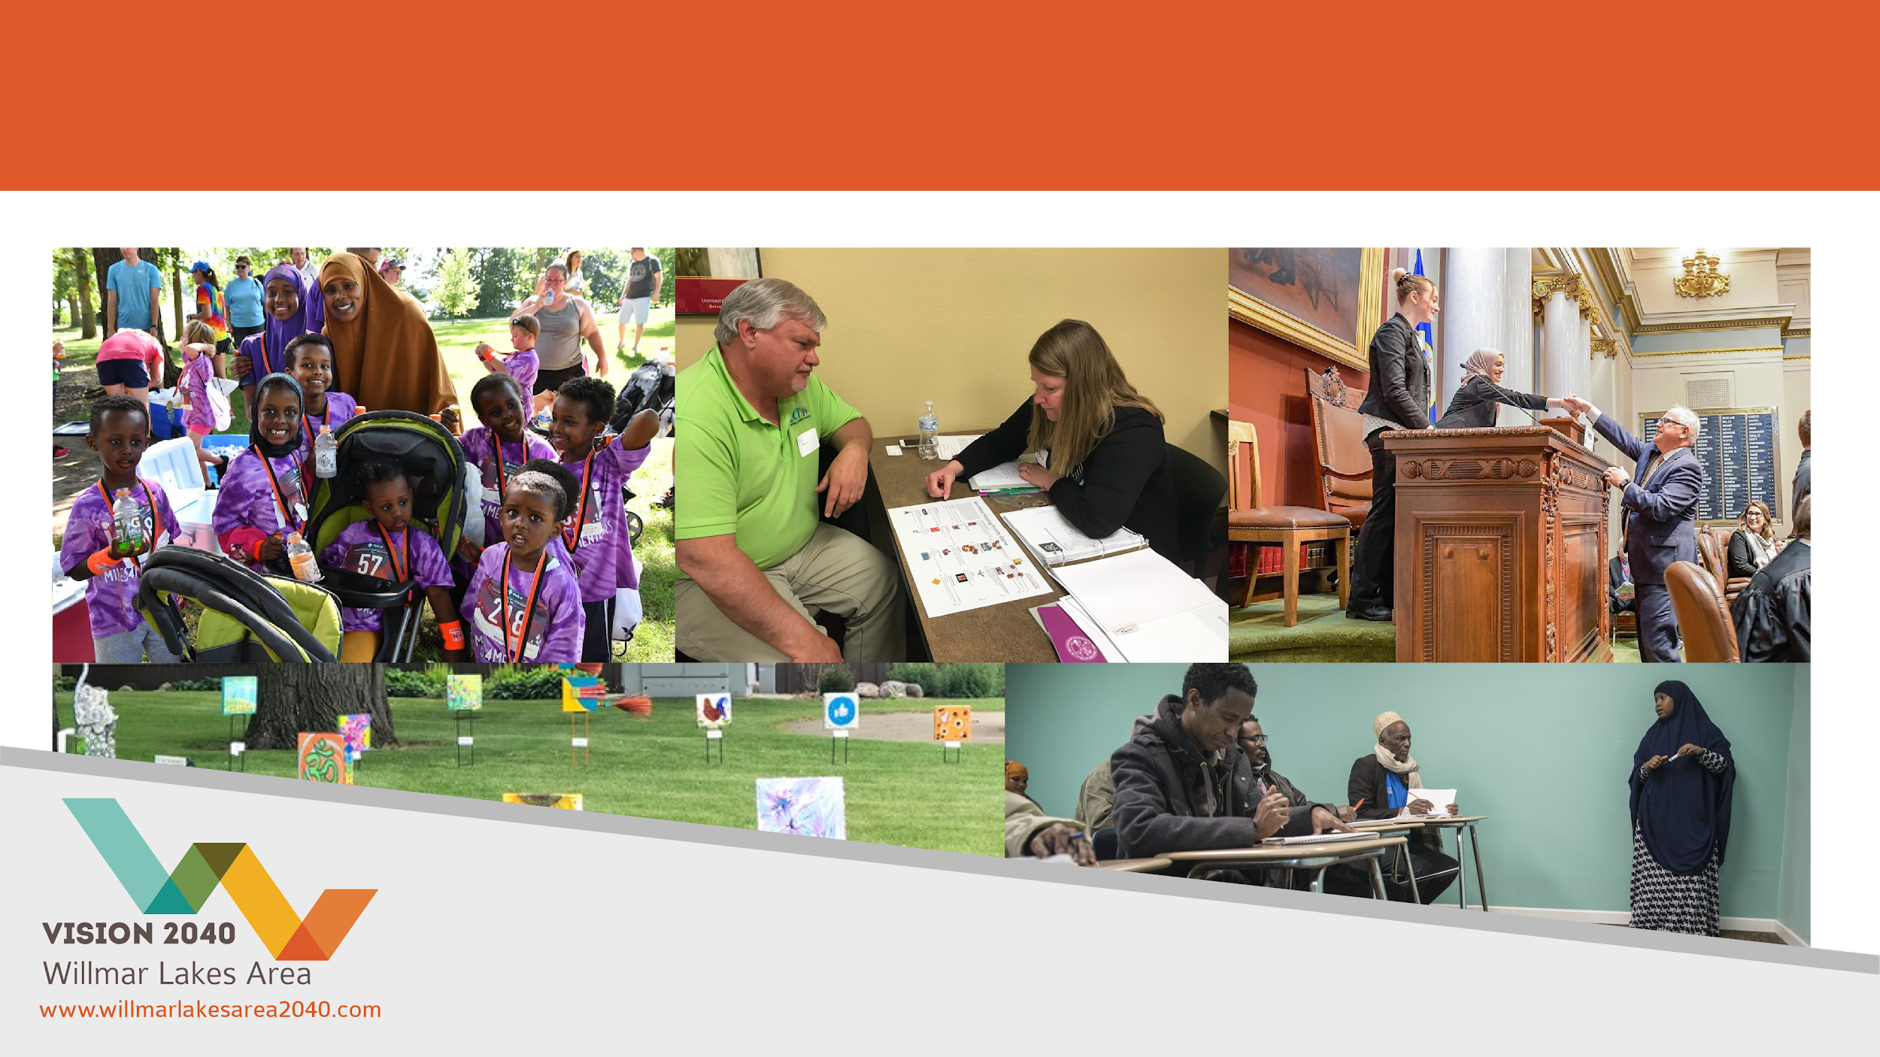
ACHIEVEMENTS

Slide 8
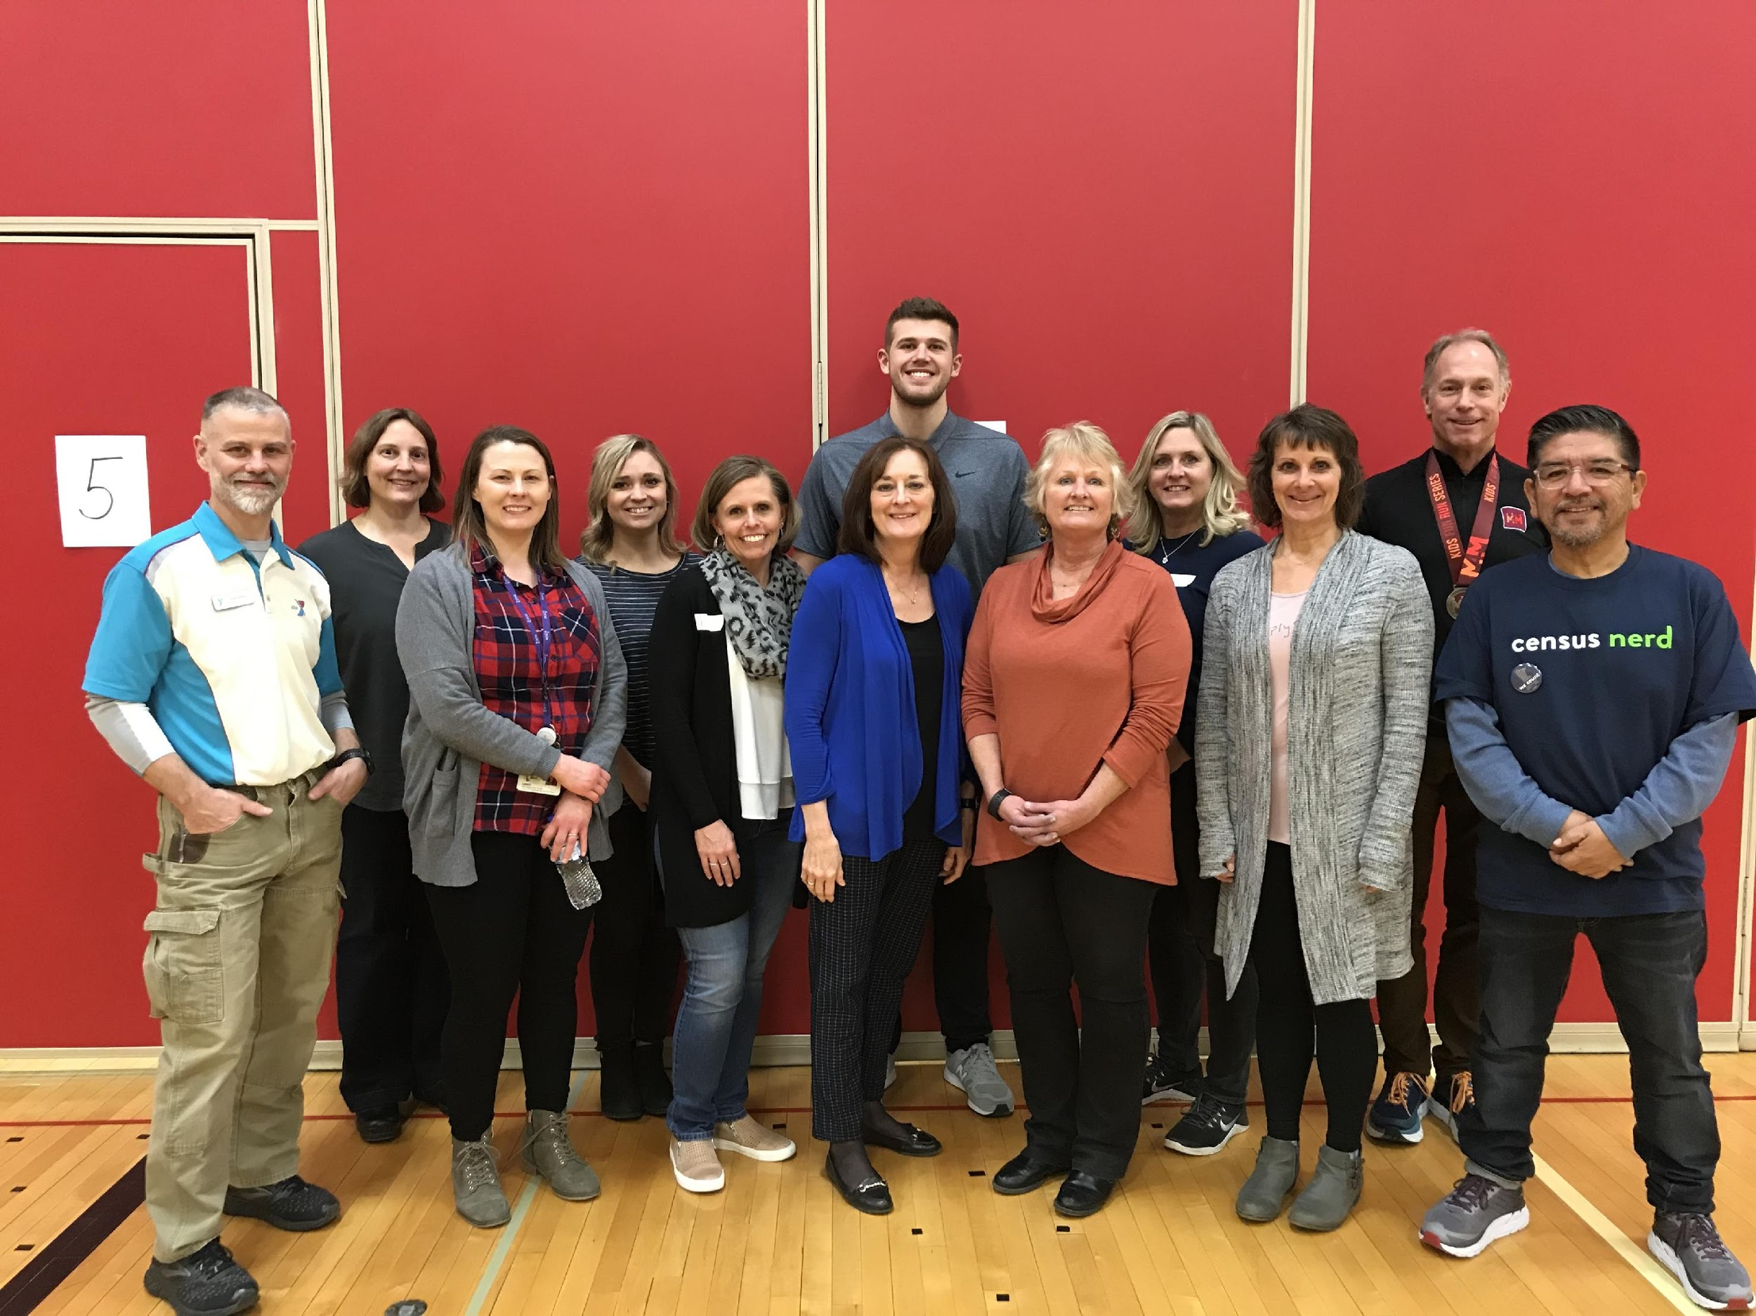
FOCUS AREA 1: HEALTH & WELLNESS
Goal Captain: Amber Silva
Improve access to health and wellness resources
Decrease rising rate of childhood obesity in the Willmar Lakes Area
Increase access to health resources
Create a collaborative regional approach to population health

Slide 9

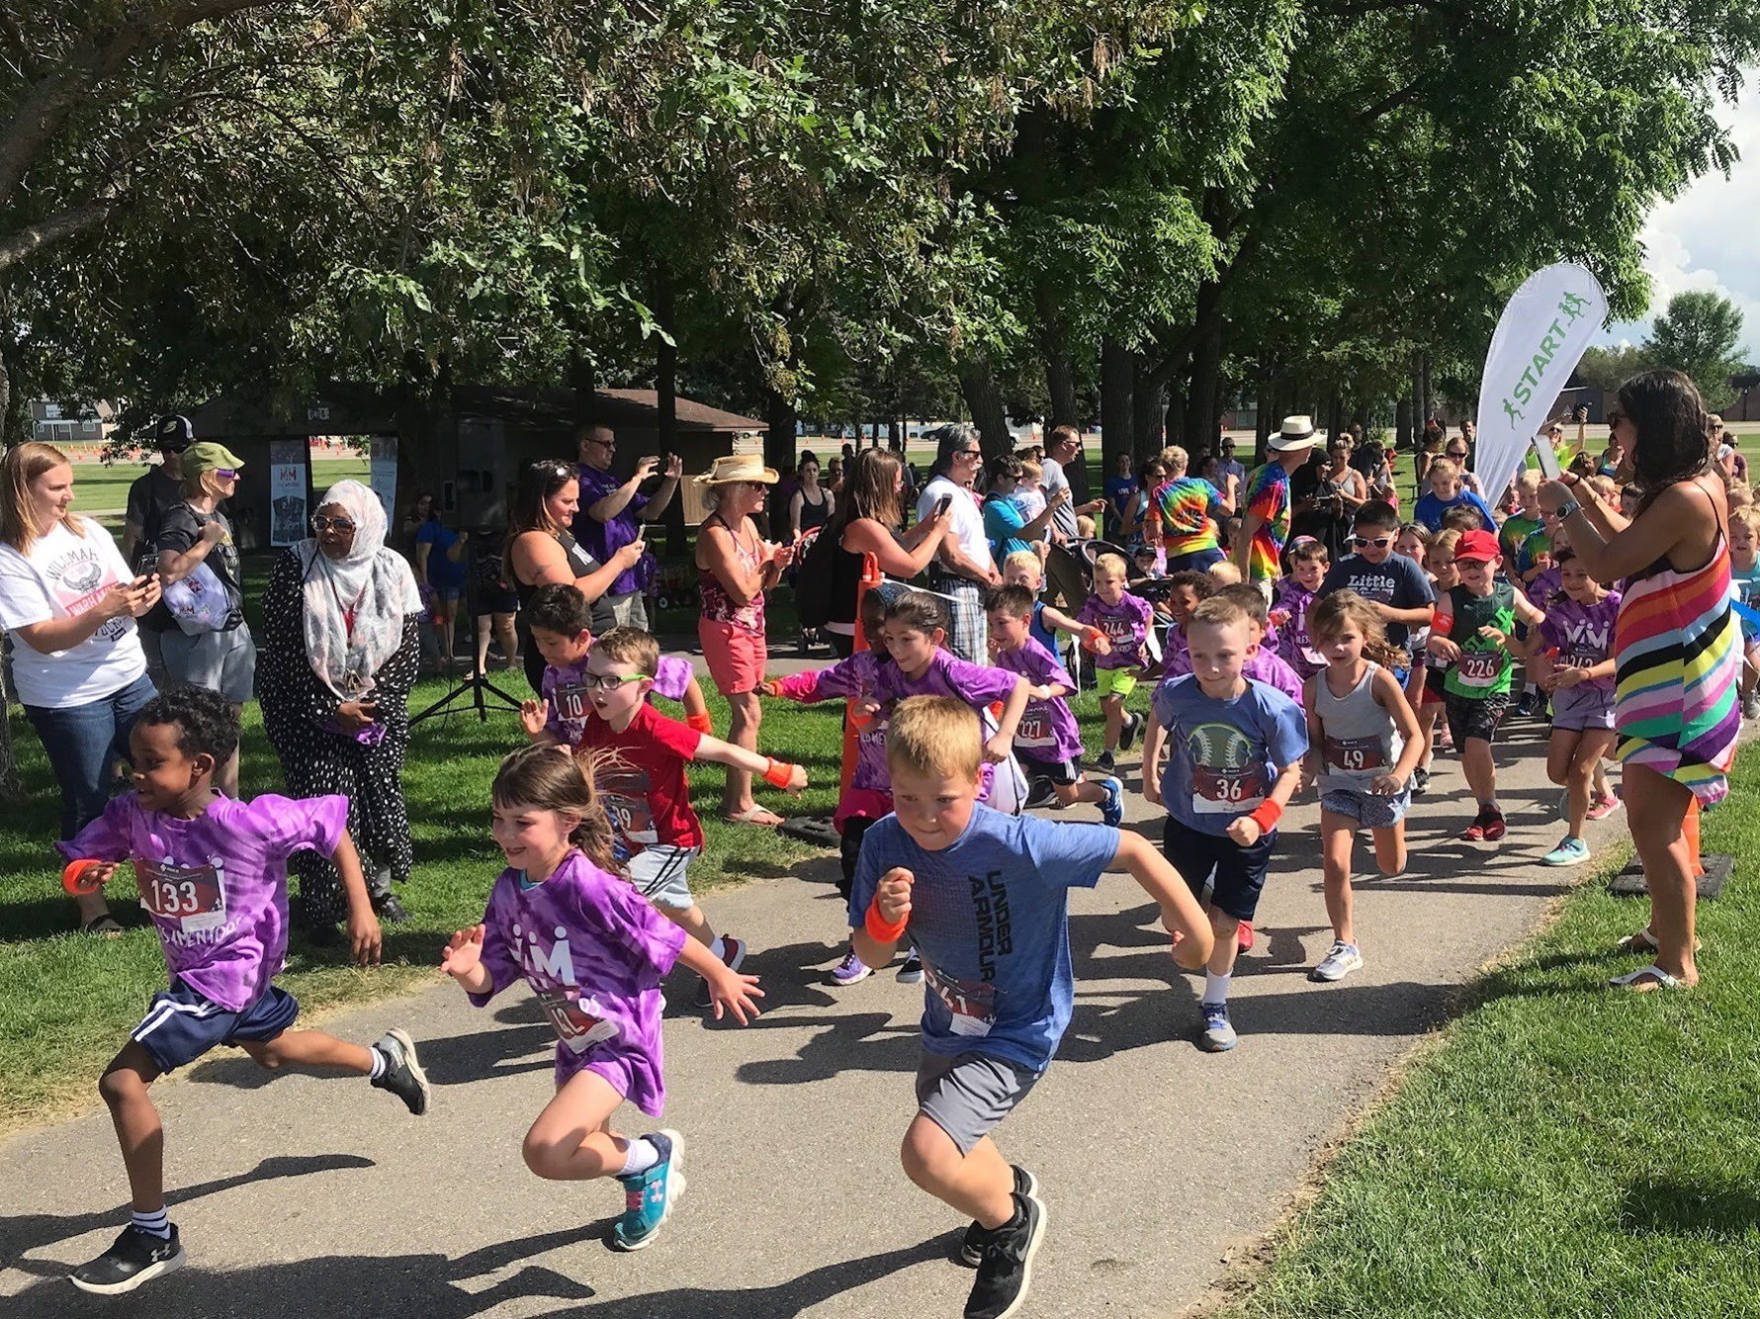
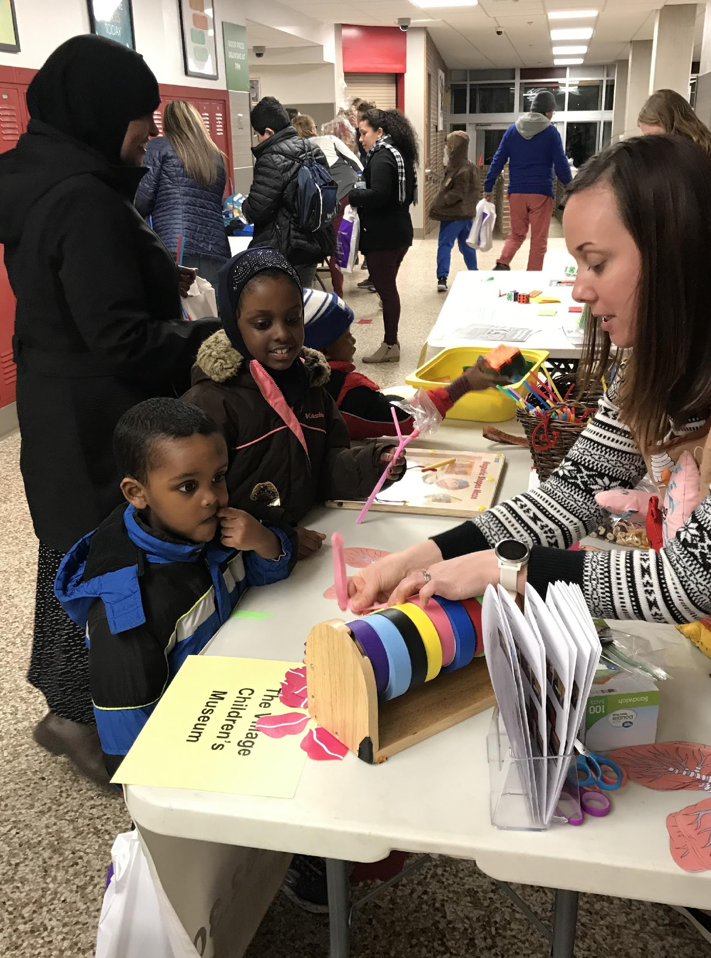
FOCUS AREA 1: HEALTH & WELLNESS
2019 Fun Run Series
Garden Box Program
Community Raspberry Bushes
Spotlight Theatre Workshop
Intergenerational Music
Love Your Health Event
2019 FUN RUN SERIES
LOVE YOUR HEALTH

Slide 10
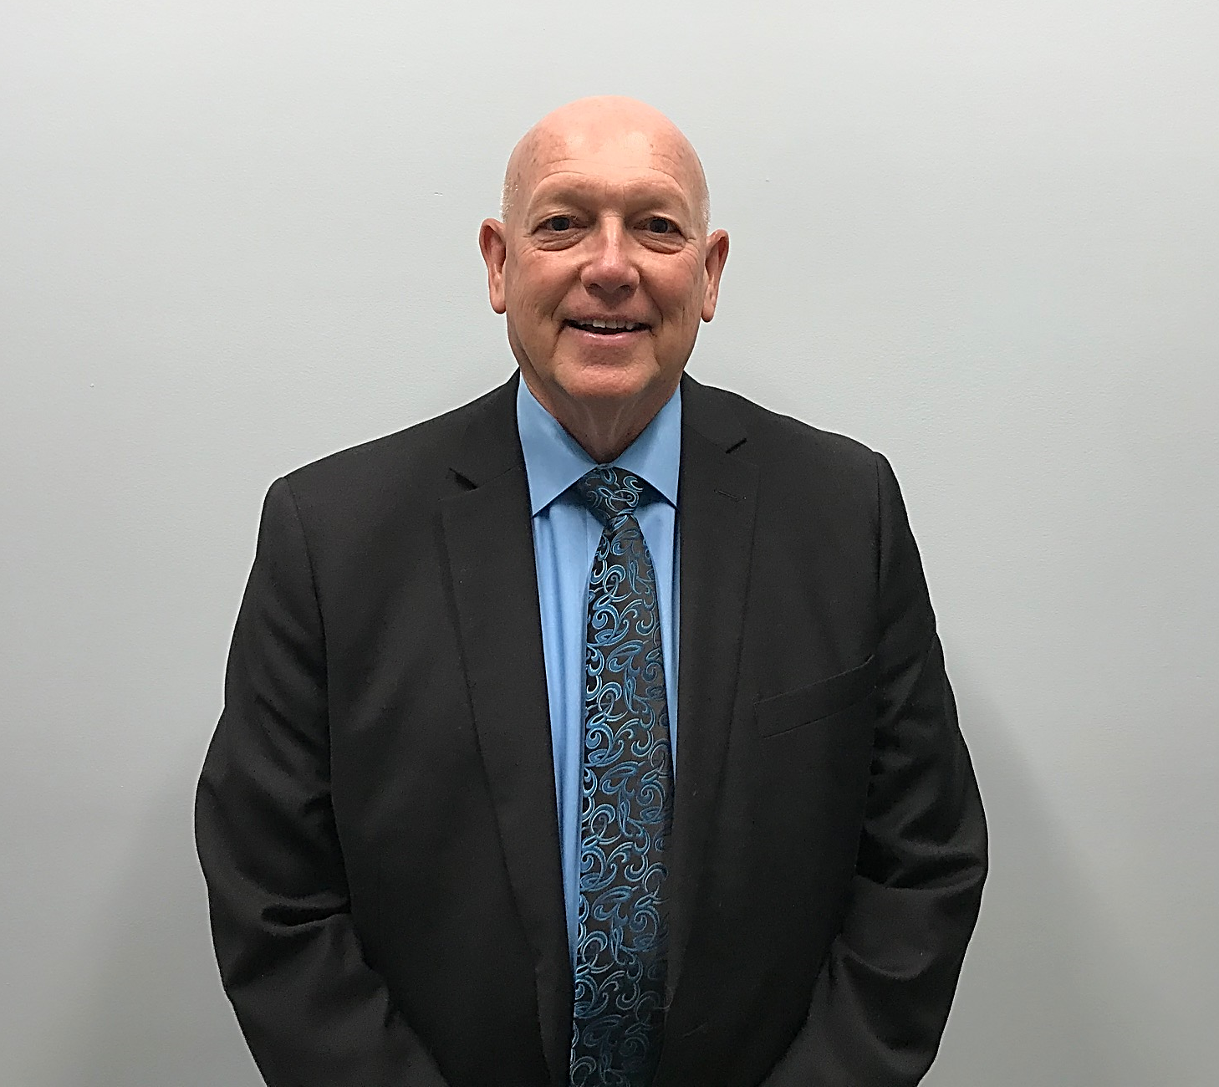
FOCUS AREA 2: COMMUNICATION
Goal Captain: Steve Ammermann
Improve communication and build relationships necessary to strengthen the community
Notification system to people about community events
County-wide marketing effort to promote connection, collaboration, inclusion and community (Vision 2040 emphasis)

Slide 11
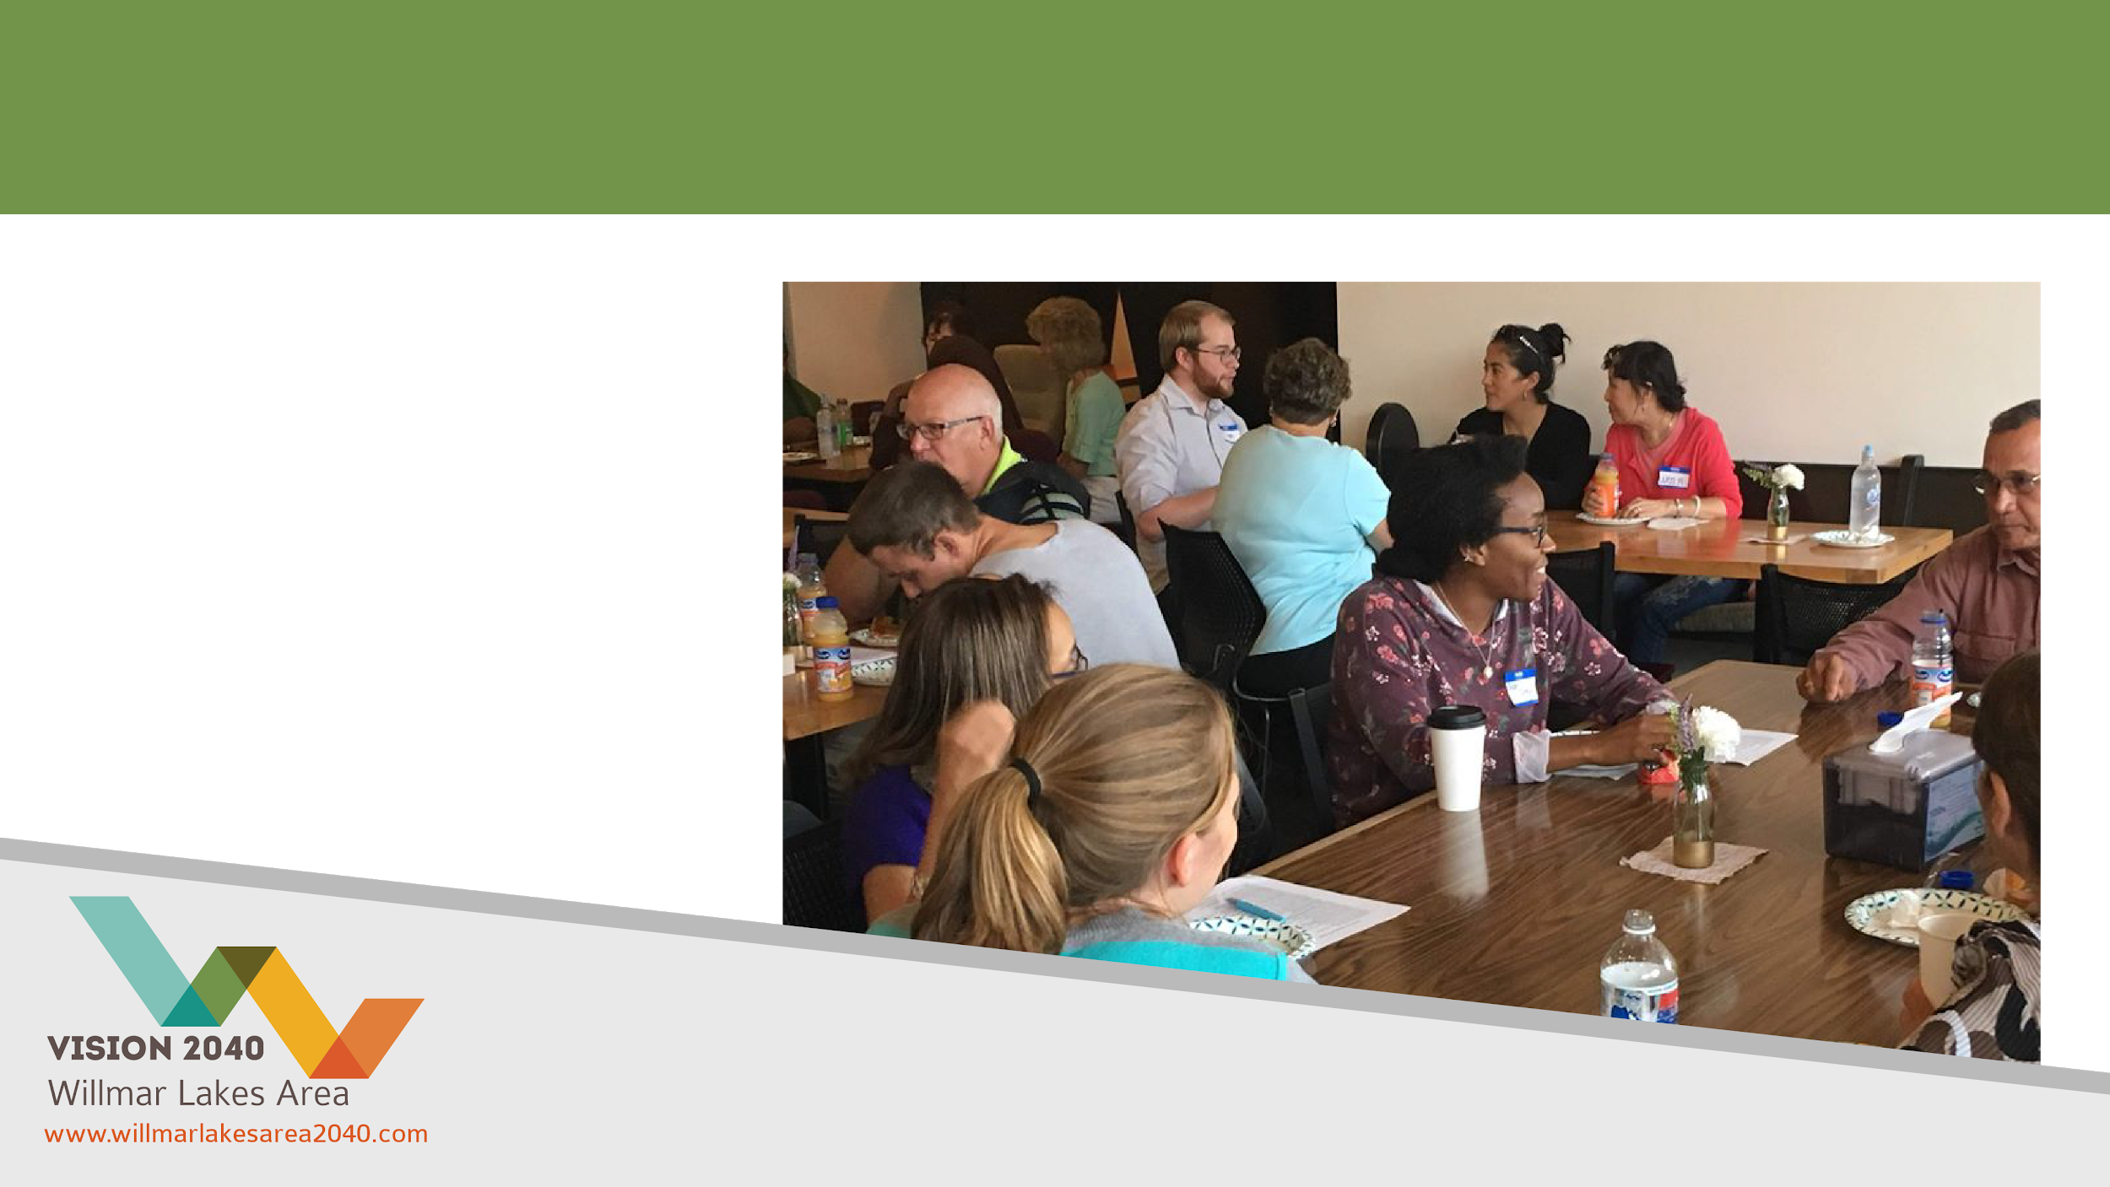
FOCUS AREA 2: COMMUNICATION
2040 Leadership
Program
Language &
Friendship Meals
LANGUAGE AND FRIENDSHIP MEALS

Slide 12
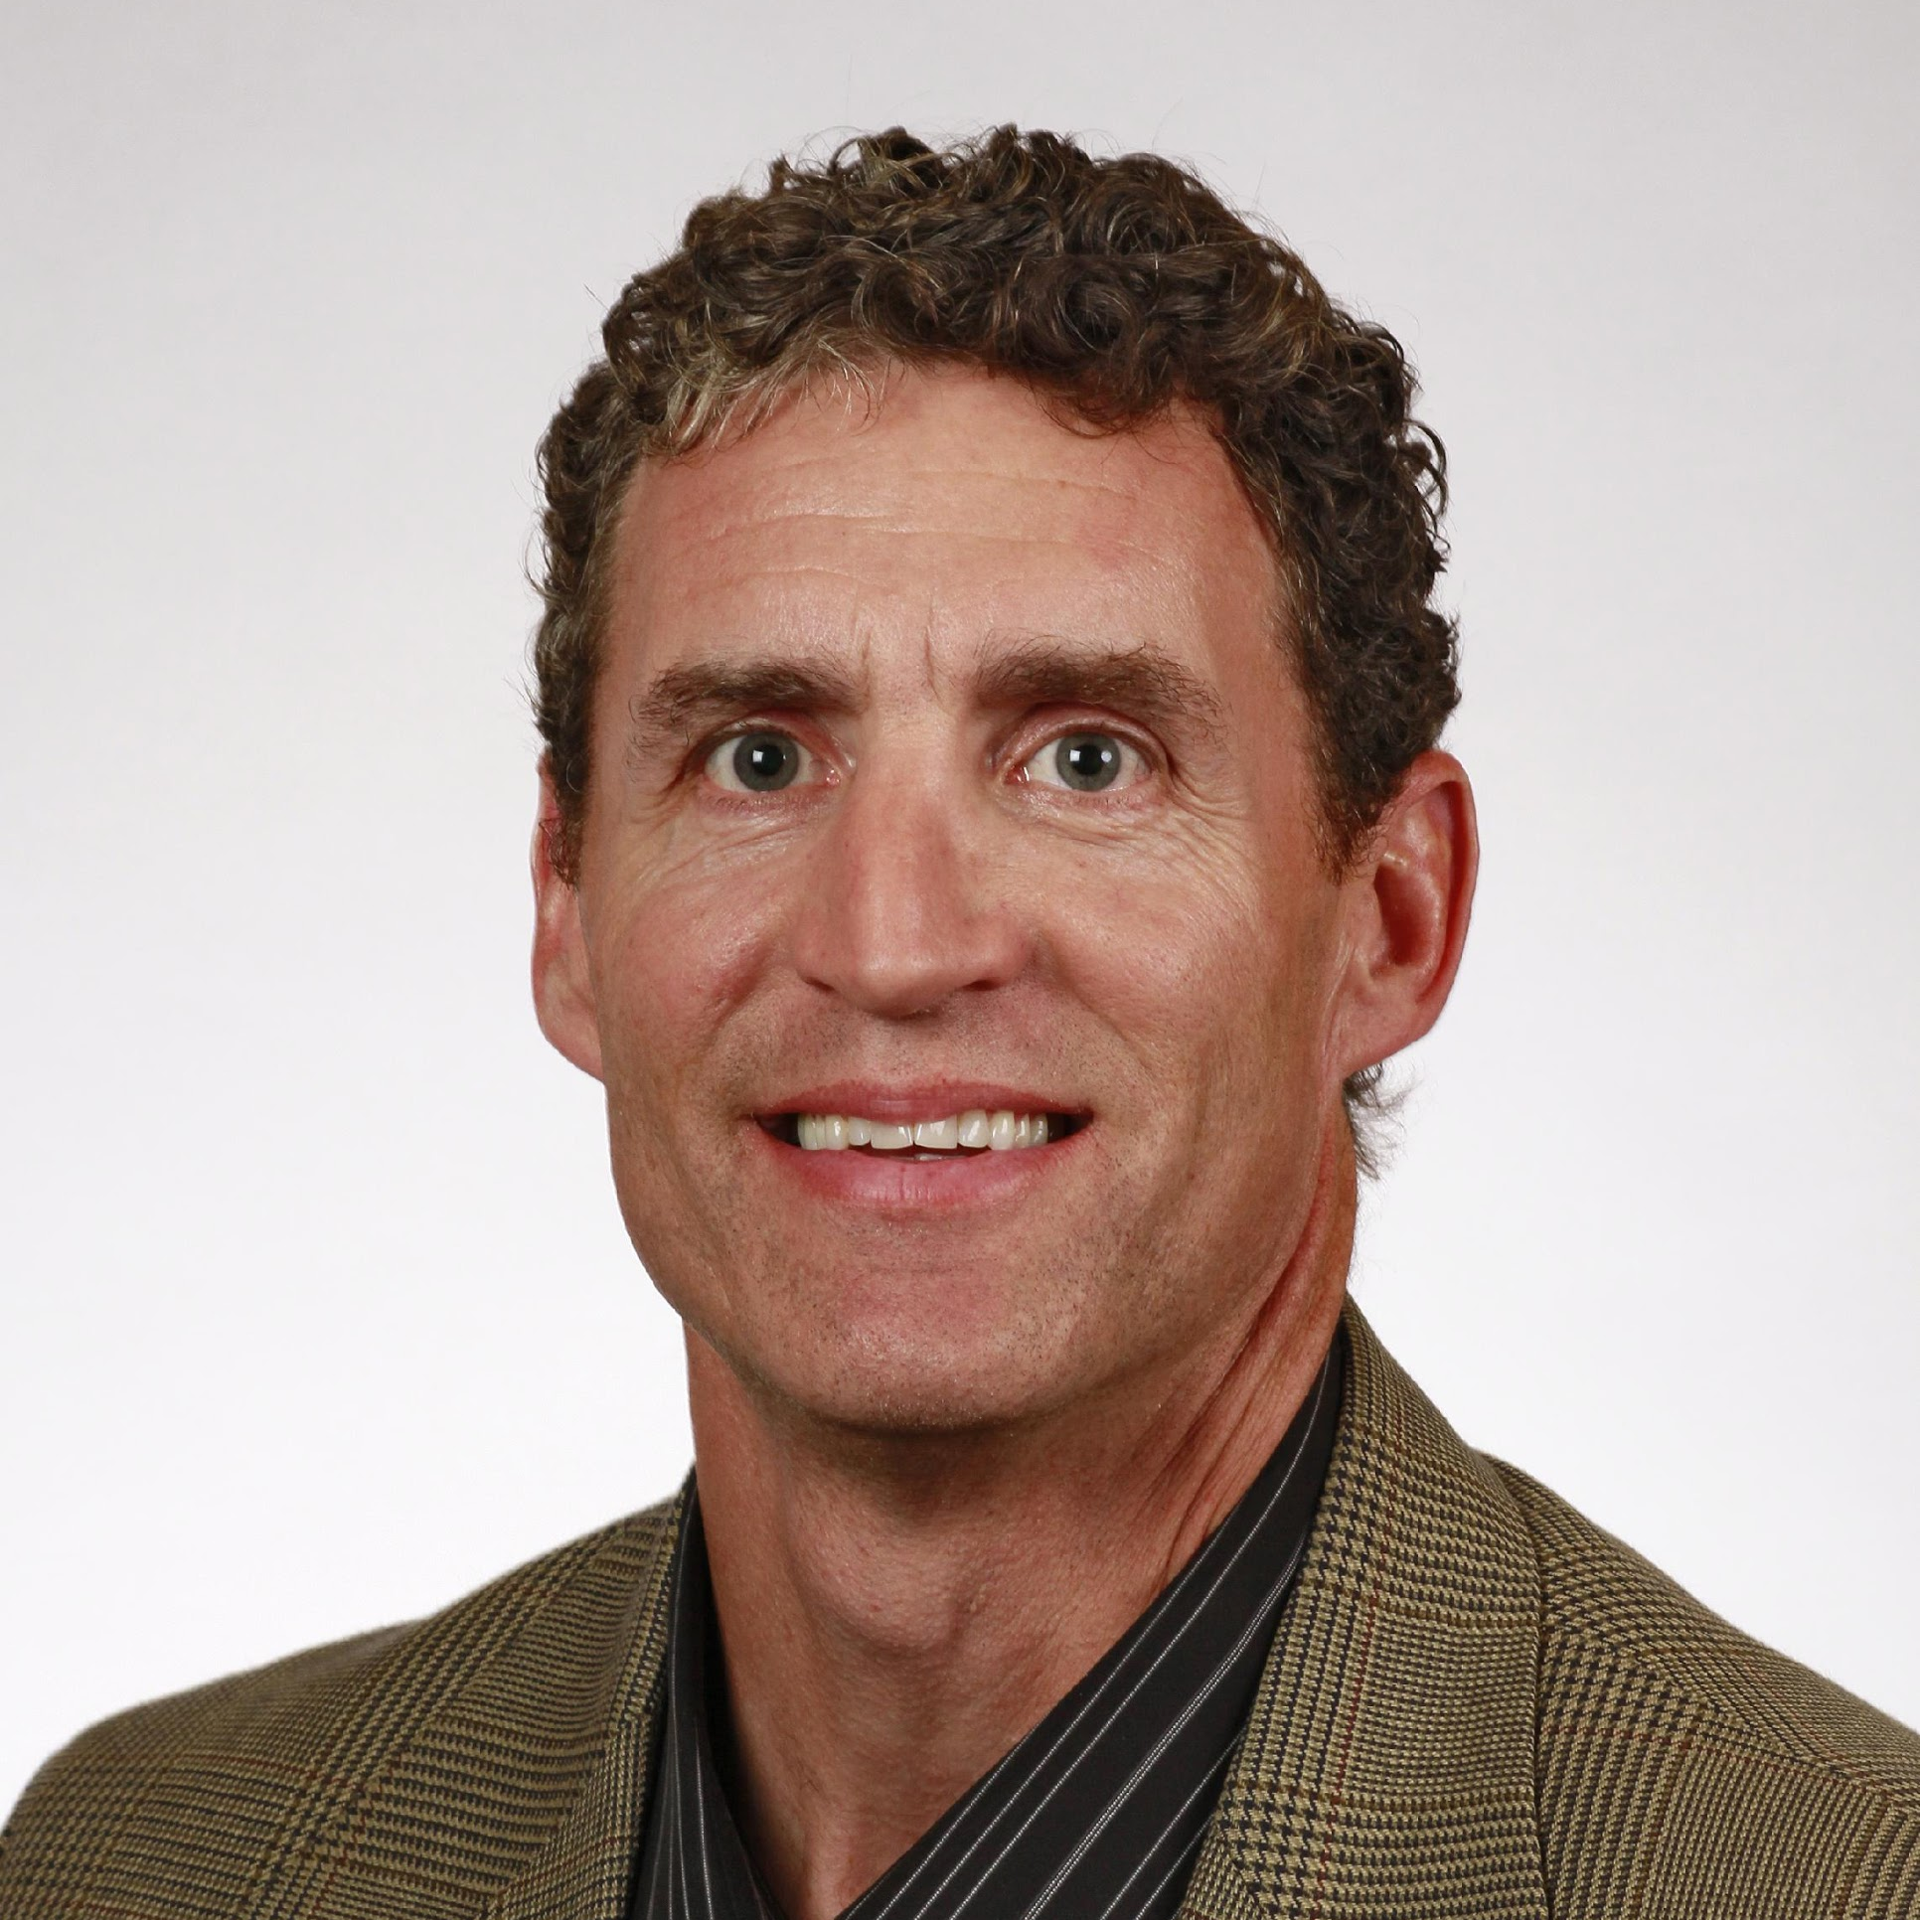
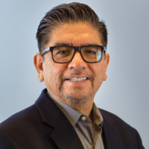
FOCUS AREA 3: INCLUSION
Goal Co-Captains: Toby Spanier and Pablo Obregon
Educate the Willmar Lakes Area community about its diverse cultures
Create a space for conversation
Plan events welcoming to all Willmar Lakes Area community members
Establish resources for new community members
TOBY SPANIER
PABLO OBREGON

Slide 13

FOCUS AREA 3: INCLUSION
Rural Refugee Project
Beautification Committee Grant
Rialto Revisited Project
Sharing Our Immigration Stories
Movies in the Park
Visibility Mural Series
Cinema Film Series
Resident Engagement
MOVIES IN THE PARK
RURAL REFUGEE PROJECT

Slide 14
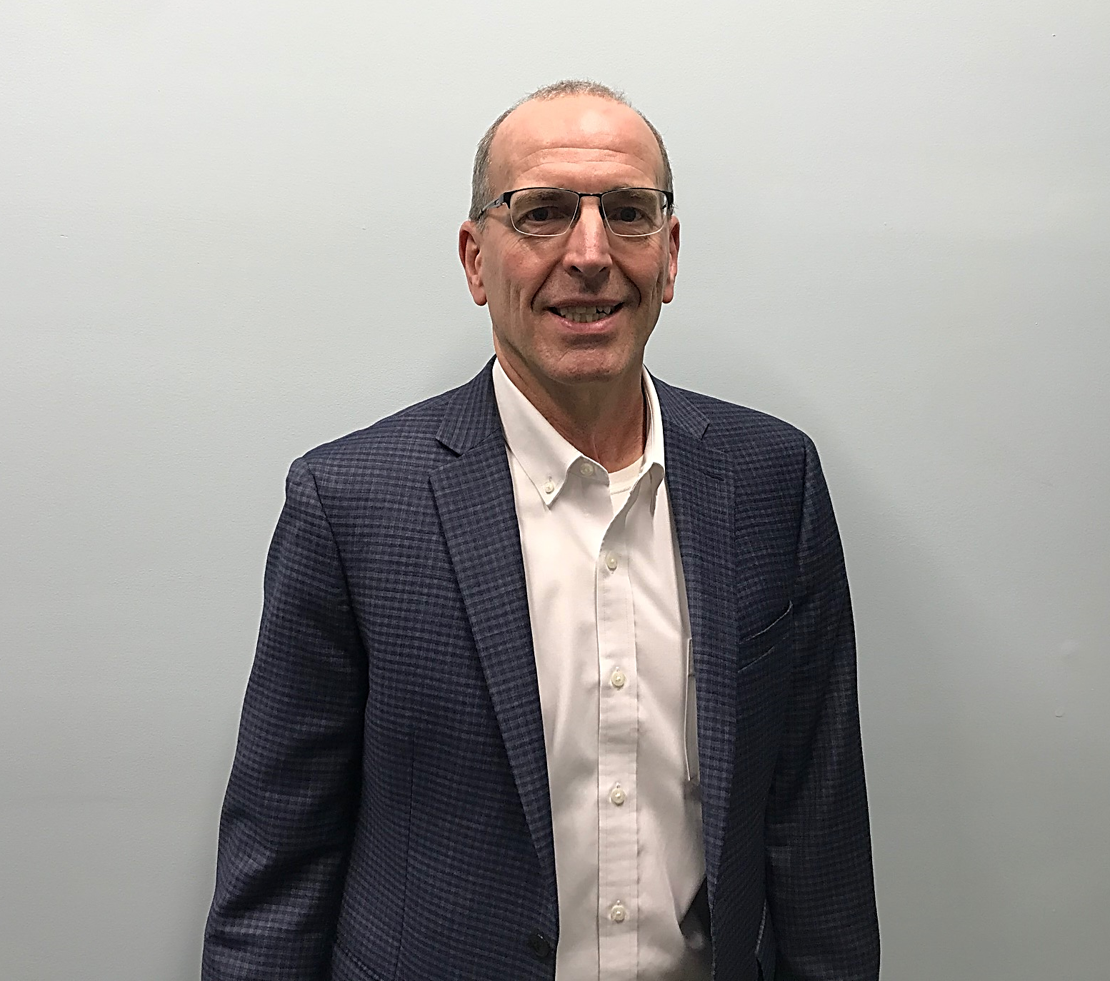
FOCUS AREA 4: ENGAGEMENT
Goal Captain: John Harren
Engage emerging leaders, youth as leaders and marginalized voices
Convene regional leaders to maximize resources
Empower community members to
work together

Slide 15

FOCUS AREA 4: ENGAGEMENT
13 Ways to Kill Your Community
Train Your Trainer
Youth in the Government
TRAIN YOUR TRAINER
YOUTH IN THE GOVERNMENT

Slide 16

IDEA WORKS
This event brought together community members who collaborated on how to implement ideas through resources, tools and funds.
Projects funded from 2019 event:
Language and Friendship Meals
Garden Box Program
Save the date for 2020 event in this Spring!

Slide 17

BOUNCE BACK PROJECT
Project Leaders: Health & Wellness Committee
Three mental health tools to be shared
Gratitude
Three Good Things
Random Acts of Kindness
Rollout to businesses and service groups
Community event this fall

Slide 18


SPEAK YOUR PEACE THE CIVILITY PROJECT
Project Leaders: Subgroup of Vision 2040 Engagement Committee
Movement to promote a sense of community by increasing civic participation with more respectful and effective communication.
Initial rollout planned for June 2020!

Slide 19
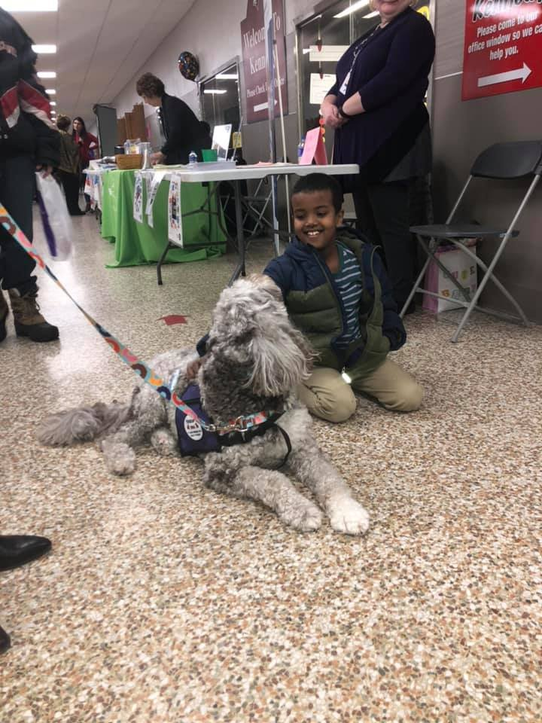
GET INVOLVED
Vision 2040 is a community effort. We hope to get more citizens involved and help more our community forward!
3 Ways to Get Involved
Join an initiative
Attend an event
Donate

Slide 20

LEARN MORE
Show your support for the amazing things that are happening in our communities by attending an event!
Check out our Facebook page for a listing of upcoming opportunities!
Find us on Facebook!
@WillmarLakesArea2040

